Slide 1
Commercialize
Design learning products that will drive revenue.
5C Framework for successful digital learning

Slide 2
Commercialize:
The fifth C of the 5C framework
Learning products are big business. Whether you’re creating digital learning to sell, looking to increase your organization’s ROI on elearning, or even getting started with extended enterprise learning, thinking commercially about your learning brings focus to what you’re doing. Who are we targeting? Is it the right product? What’s the investment? And, crucially, how will it deliver a return?
The fifth C of the Elucidat 5C Framework is Commercialize; it’s all about how you can use Elucidat to achieving the best outcomes for your business as well as your learners.

Slide 3
SCALABILITY
Many Elucidat customers, including SAI Global, are successfully commercializing their digital learning products. This Commercialize Guide looks at the three factors we see at the heart of these successes.
Scalability
Quality
Speed
Need some support? Find out more about our Learning Consultancy team and our coaching and design services at each stage of the 5Cs Framework.
QUALITY
SPEED

Slide 4
1
Scalability: Increase the reach of your products through distribution and marketing
Whether you’re a training provider organization or leading an in-house L&D team, engaging as many learners as possible with your digital content is often the name of the game, and the modern sign of success.
Could you reach new markets and audiences if you…
Efficiently release courses in multiple languages, significantly increasing your potential customer base?
Provide truly multi-device and accessible learning, making you an attractive options for customers with large groups of end users?
Find new ways to distribute your content, so you can be flexible to your customers’ needs?
Market your products with top end strategies that give you the edge over your competitors?
Think virtually - how will you get others talking about and voluntarily sharing your product with peers and colleagues?
Jot down your thoughts Can you promote your products on multiple channels? Is an LMS right for (all) of your audience?

Slide 5
Your chosen distribution model will determine who has direct access to your learning products, and therefore who you’re marketing to. Here are a few popular distribution models and factors to consider.
Model | B2B Sell to L&D or HR Professionals in businesses who are looking to train their staff. | Self-serve Let customers come to you and select the products they need from an online store. | Direct to learner Learning from organizations like LinkedIn learning, target learners looking to self-develop outside of work. | Text Allow organizations to pay a monthly of annual fee for access to a library of products.
Considerations | Are your products SCORM compliant? If your products rely on LMS features like discussion forums, is there a back-up for customers without this software? | Are you set up to host multiple live courses? Would you want to group some learning products together into programs? Can you make the user experience as easy as online shopping experiences? | Can you give learners a certificate or alternative recognition of their achievements to share? Are the benefits of your products clear to the end user themselves? | Will you have different subscription packs to suit different budgets? Can you keep adding to the library so customers see continuous value year after year?

Slide 6
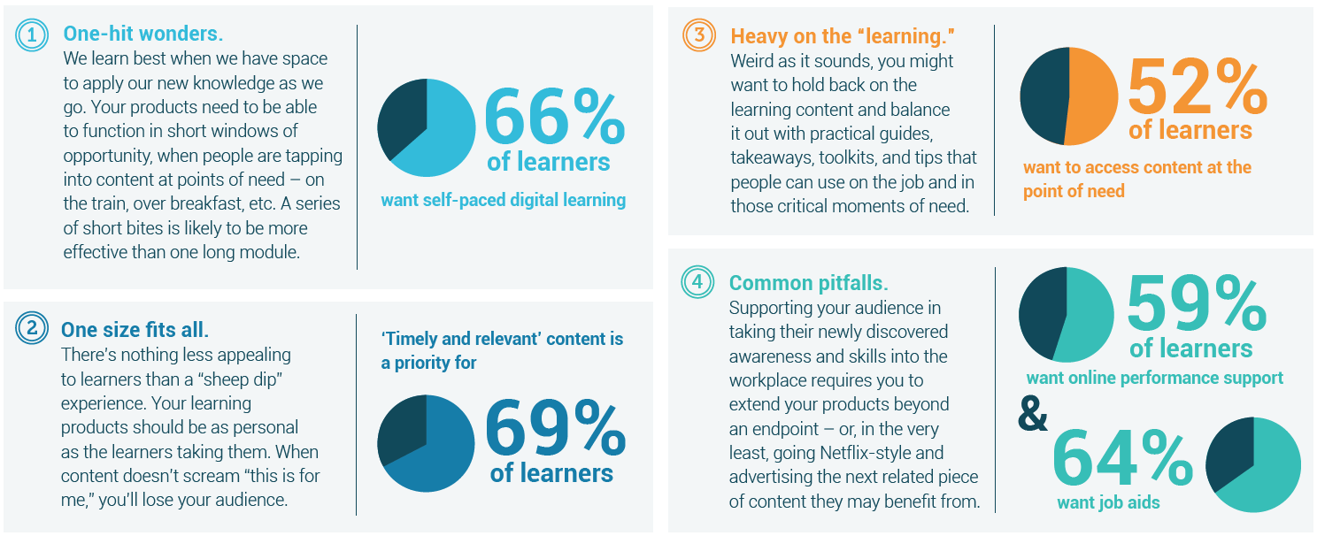
2
Quality: Designing compelling products that people want to buy
If you’re creating digital learning, you’re in one of the most competitive markets. How do you stand out from the crowd and create “sticky products that people want to use, time and time again? Avoid some common pitfalls:
Part of avoiding those pitfalls is carrying out market research to uncover what will work for your potential customers.

Slide 7
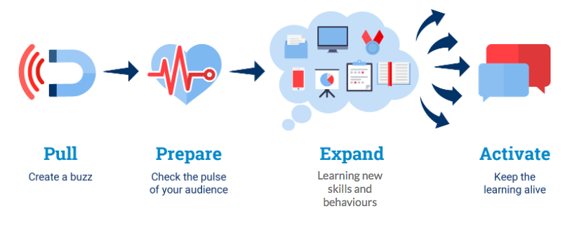
What about your audience? Look into the following.
Target Buyers | End learners | Competitors
Find out what our buyers’ success criteria is, and consider how you can deliver in it. Understanding the skills gaps your target buyers are focussing on. | Consider the profile of today’s learners. Build audience profiles using our Capture Needs Template. | Learn from successful digital training providers. Determine your USP.
Are you supporting the whole journey?
Consider the whole journey a learner goes on. They often start from “I don’t know (or care!) about this topic”, and yet need to end up at “I want to share my new skill/knowledge with others”.

Slide 8
Different digital products are better suited to different stages in this journey, and each stage is an opportunity to provide a product and drive revenue.
Jot down your thoughts
Which parts of the learner journey could you give more attention to? How can you (re)package up your learning content to support more than one stage?
Pull | Prepare | Expand | Activate
Teaser/trailers Email comms Digital poster | Diagnostics Profile builders Intro animations Infographics | Microlearning hub Simulations Immersive environments Quizzes | Curated content Discussion forums On-the-job resources

Slide 9
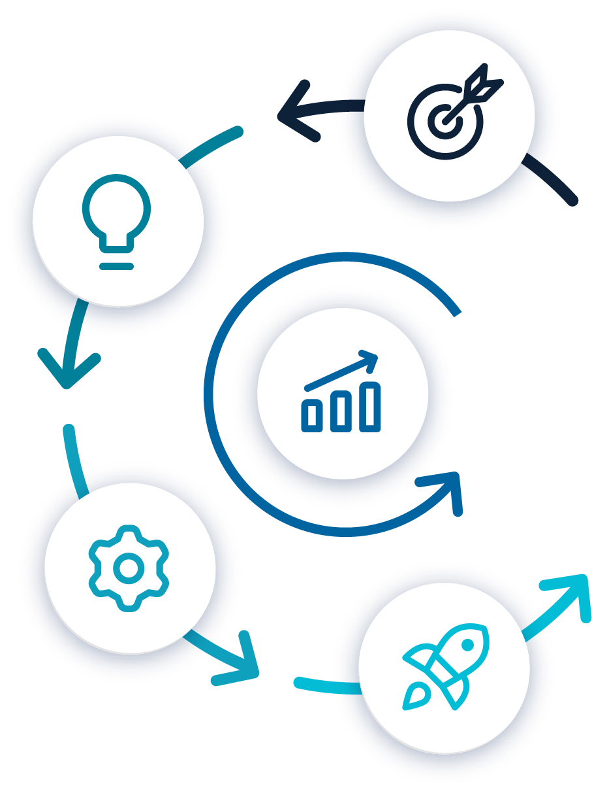
3
Speed: Create product efficiently to increase speed to market
Once you know which learning products you’re planning to build, smart workflows will make the difference between getting them done on time with minimum cost, and getting caught up in a long and costly productions process.
Experience shows us that, even when time is of the essence, starting at the beginning and taking time to build a clear plan and detailed vision will keep you on the straight and narrow as you build. If you haven’t seen them already, we have free guides and toolkits like this one for each step in our recommended 5C Framework for creating successful digital learning.

Slide 10
There are several extra considerations to take into account when you’re planning to work at scale and across different markets. Planning for these early on will help you launch your learning products faster.
Reducing agency costs: If you already have a team of subject matter experts, you can reduce your outgoings significantly by purchasing an intuitive digital learning authoring tool that enables them to author their own content rather than always having to pay agencies to do it for you.
Translating content efficiently: If you think there’s a possibility of translation, go for a tool that enables the simple swapping out of languages without requiring authoring time. Design with this in mind - choose layouts, images and diagrams that will translate easily.
Managing variations seamlessly: Consider from the off if you might need to rebrand your products, white-label, or create slight variations in content. Design with this in mind from day one. Choose an authoring tool that facilitates multiple variations of one product, without heavy production headaches.
Streamlining collaboration and review: Many hands make light work. Collaborative technologies enable experts, reviewers, and creatives to work together to create products, fast. Avoid blockers by choosing a cloud-based authoring tool that allows multiple people to work on a project at once.

Slide 11
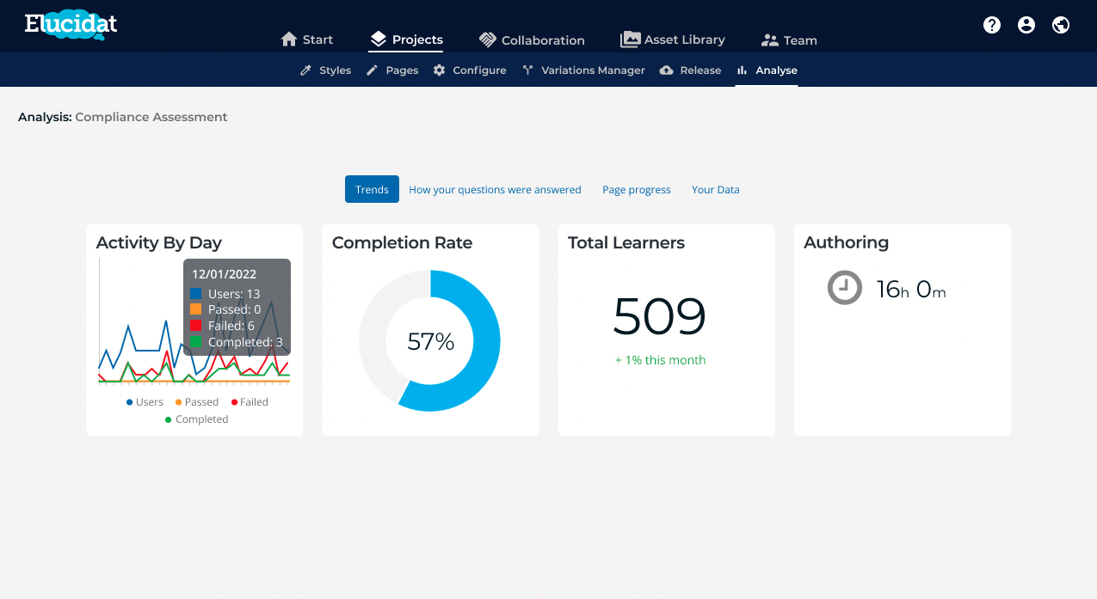
Investing a lot of time creating products before you know whether they’ll work can feel risky. Work smarter by user-testing short prototypes, reading the data that comes back, and building areas for improvement into your workflow.
Get further tips on how to read your data in our free Cultivate Guide.
Jot down your thoughts What would help your organisation speed up the production of digital learning? Have you got any existing content that could be smartly reformatted or simply linked to? And how can you engage subject matter experts with creating new content directly? Consider templates or encouraging them to get stuck in with an authoring tool.
Armed with your notes on the commercialization techniques that are best suited to your organisation, you’re ready to plan successful digital learning products that will drive revenue or ROI. For more support generating revenue through learning, get in touch.

Slide 12
Commercialize
We hope you’ve found this guide useful!
It’s just one part of our 5Cs Framework for effective digital learning design, which can support you as you create people-centered elearning.
If you’d like one-to-one support with getting actionable insights from your data, our Learning Consultancy team can help, please get in touch.

